Slide 1
Car Price Predication In Saudi Arabia
Using Linear Regression
By
Ahmed Almuyabid
Abdulrahman Alrifae

Slide 2
OUTLINE
01
Introduction
02
Data
03
Model Selection
04
Conclusion Q&A

Slide 3
Introduction
Saudi sale is the most popular website for selling new and used cars in Saudi Arabia., it offers car tire search, registration price calculation, and others. Main idea of this project is to analyze car price posted on the website, and predict the price of a car in relation to all the other cars posted on the website. The methods of machine learning used to achieve this are linear , ridge and Lasso regression.

Slide 4
Tools
1st
2nd
Pandas and Numpy
BeautifulSoup and selenium
3rd
4th
Dython, Seaborn and Matplotlib
Sklearn, OneHotEncoder
5th
Google Colab

Slide 5
Data
(web scraping)
1. Saudisale.com
2. Selenium & BeautifulSoup
3. 10,000+ Cars
Pickle

Slide 6
Data
(EDA)
1
Convert to integer
2
Remove outlier
3
Missing Value
4
Visualization

Slide 7
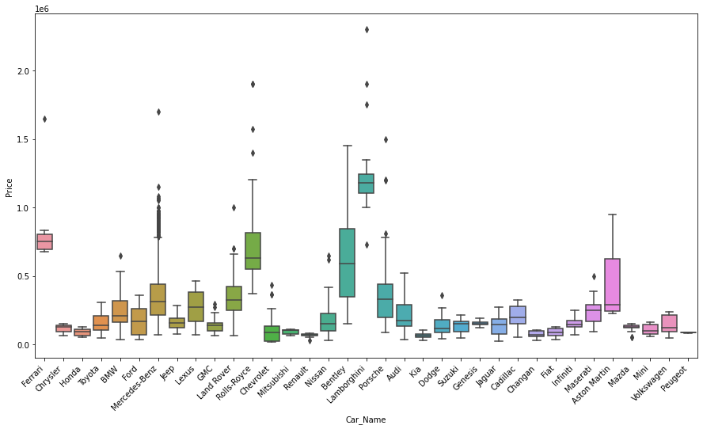
Data
(Boxplot)

Slide 8
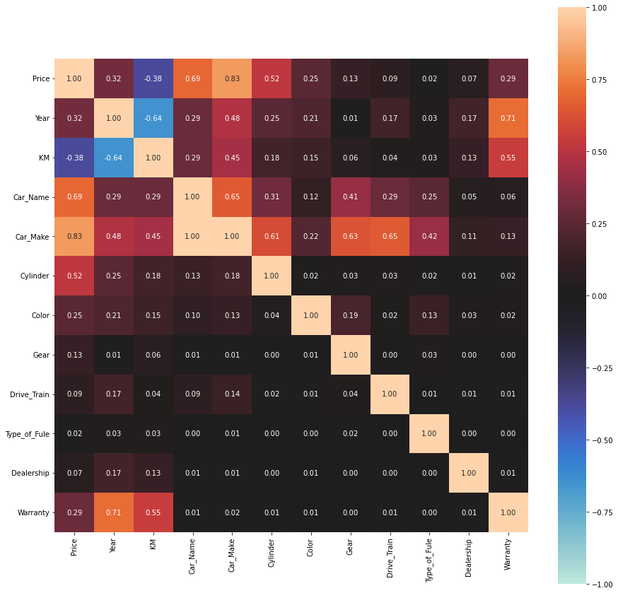
Data
(Correlation)
Notes:
Pearson's R for continuous-continuous cases
Correlation Ratio for categorical-continuous cases
* Cramer's V or Theil's U for categorical-categorical cases

Slide 9
Model Selection
Target continuous
Linear Relationship
Linear Regression
No perfect multi-collinearity
Variance of residual is constant
The error terms are normally Distributed and zero population mean

Slide 10
Model Selection
(Performance)
Linear Regression Model
Model Name | Train Score | Validation Score | Test Score & MAE
LinearRegression | 0.850 | 0.833 | 0.816 & 61203
Lasso | 0.858 | 0.795 | 0.799 & 59525
Ridge | 0.849 | 0.836 | 0.816 & 61338

Slide 11
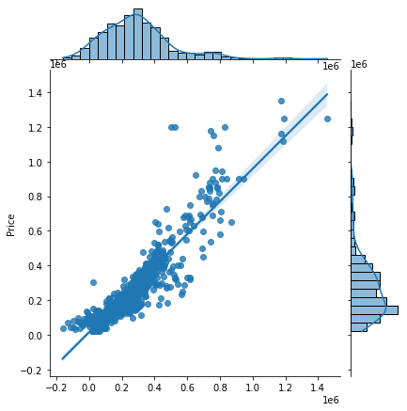
Model Selection
(Visualization Linear Regression)

Slide 12
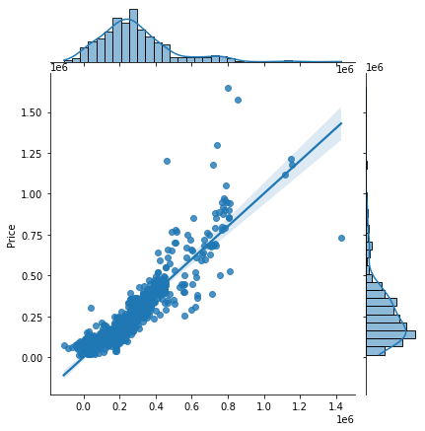
Model Selection
(Visualization Lasso)

Slide 13
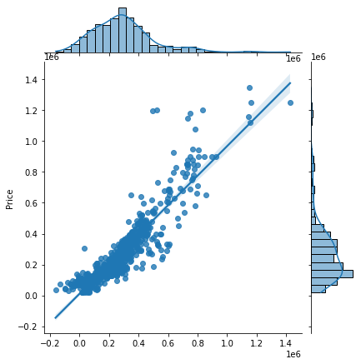
Model Selection
(Visualization Ridge)

Slide 14
Conclusion
- Main data was web scraped
- Boxplot was used to define outlier
- Lasso model is the best fit
- The use of dython to find correlation between categorical feature

Slide 15
Thanks for Listening Any Questions?

